Slide 1
iops
Iops stands for Intelligent Operations.
Iops consolidates all the data it has captured will be segregated and displayed in graphical and numeric values by which everyone can be understand.
Where we can able to see web apps URL Availability, Server Rebuild Status, Data Growth, Storage Stats And Infrastructure both DEV and Prod.
Following is the URL for iops:
http://dnaops.corp.wabtec.com/iops/#/Content/CurrentStatus

Slide 2
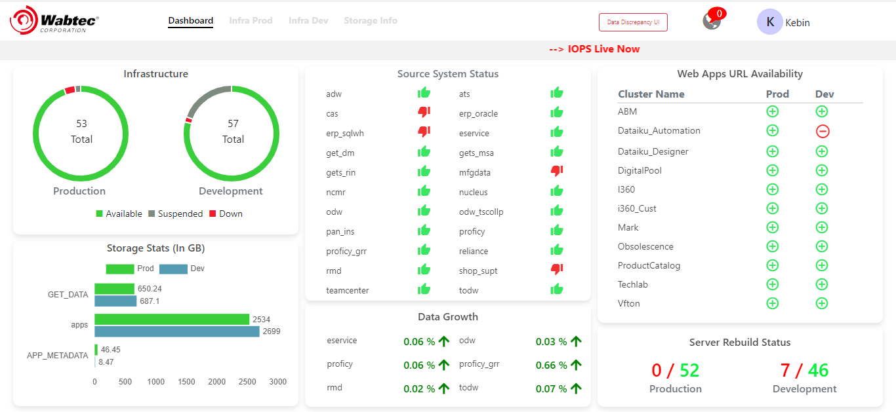
Dashboard:
Dashboard of iops will collects all the data from tools integrated with and prepares a report and shows in different section with respect to their category and division it belongs to.

Slide 3
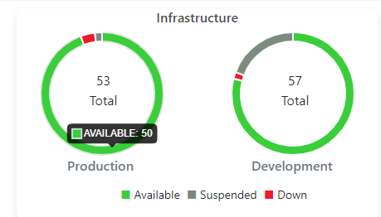
Infrastructure Health:
Infrastructure Health section provides the information about the Hardware used from Mirror Data Layer to Data Reporting Layer.
By keeping the mouse pointer on the Graph, it will give the count of the Servers.

Slide 4
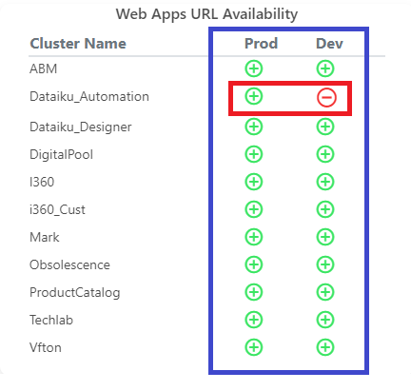
Web Apps URL Availability:
Here in web apps URL we can see the status of clusters, whether it is available or down( Both Prod and Dev).
By clicking those Symbol it will redirect to particular cluster URL, so we have complete control to monitor things in one dashboard.

Slide 5
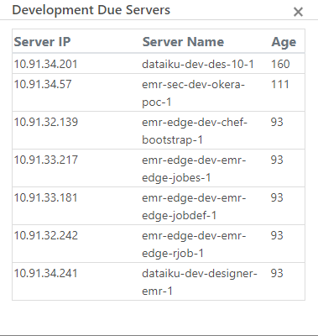
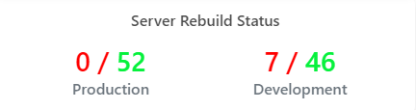
Server Rebuild Status:
Here we get the total count of servers, out of that how many crossed the age of 90 days. The age of above 90 will show in red.
By clicking the number in red, we will get the server IP, Server Name and Age of it.

Slide 6
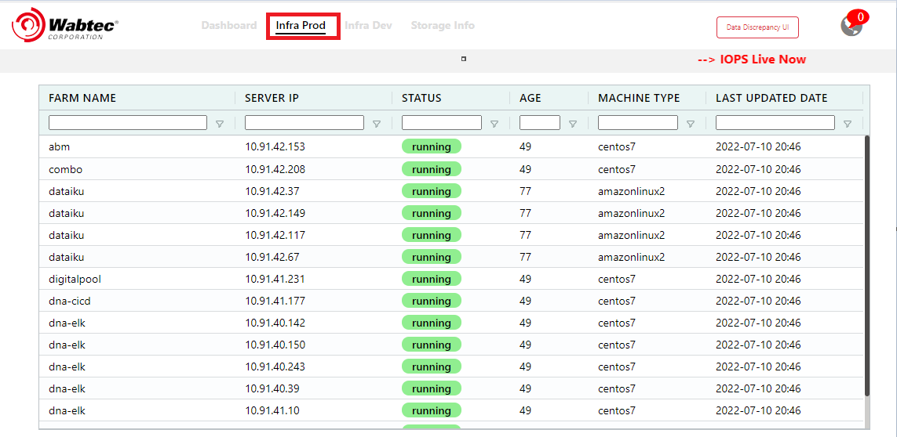
Infra Prod:
This tab shows the Farm Name, Server IP, Status, Age, Machine Type and Last updated date in production.

Slide 7
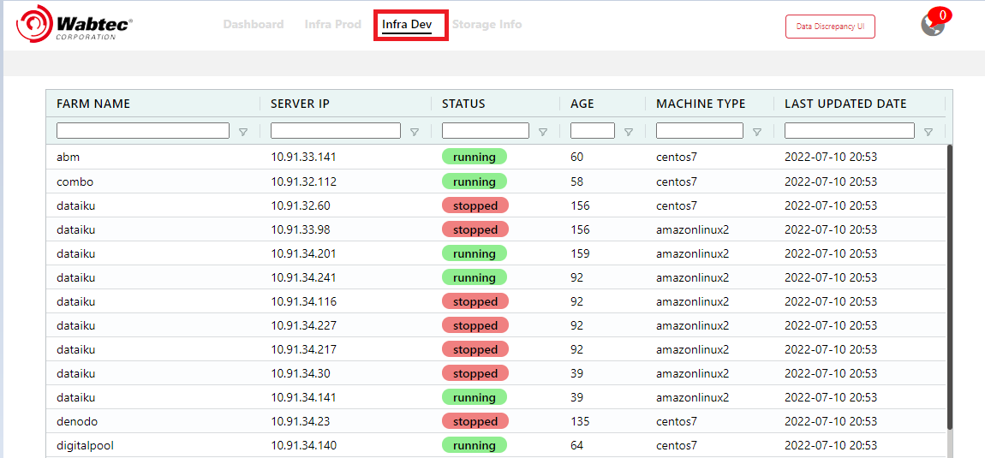
Infra Dev:
This tab shows the Farm Name, Server IP, Status, Age, Machine Type and Last updated date in Development.

Slide 8
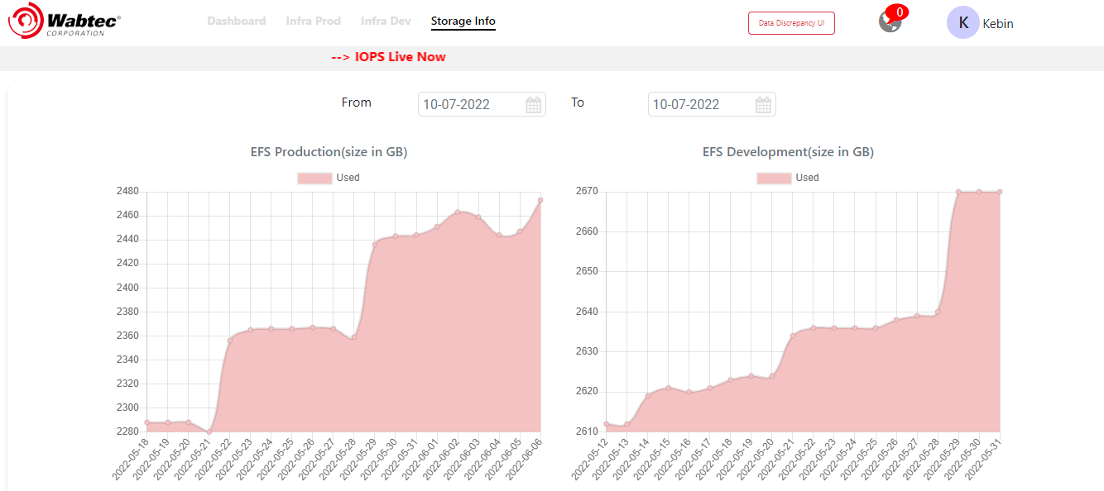
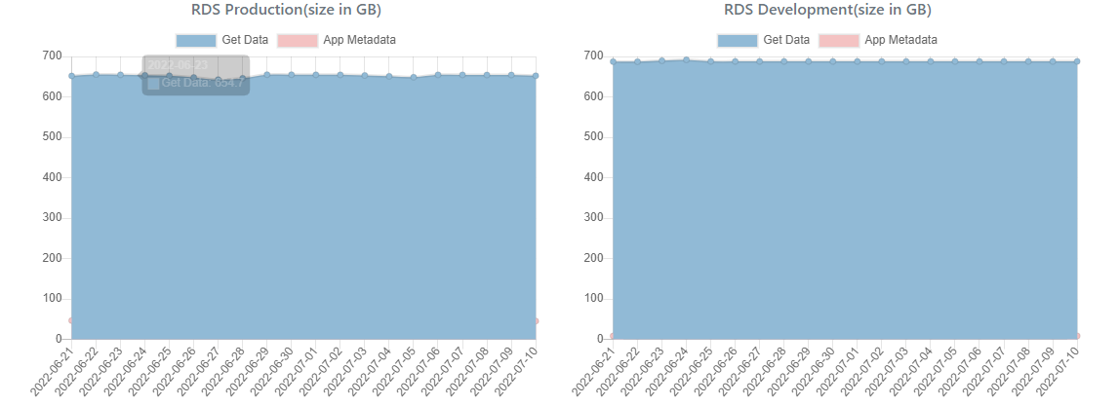
Storage Info:
We have different kinds of storages like EFS, RDS and S3.
EFS and RDS are shown in the size of GB.
Where S3 is shown in size of TB.

Slide 9
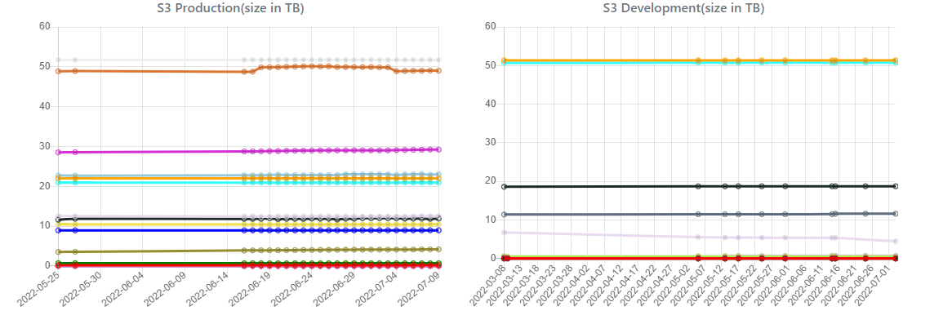
These are the process of monitoring we will do in iops.
Thank you.

